Slide 1
MicTherm – LBM Coupling Idea

Slide 2
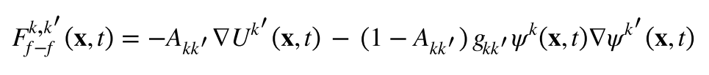
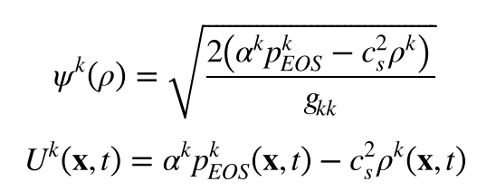
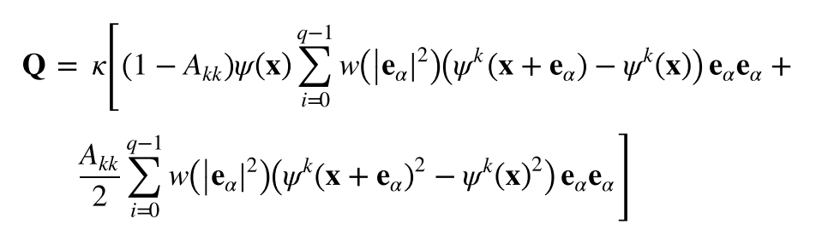
Basics
3 relevant model parameters (non-physical): A, alpha, and kappa
A, alpha: determine phase densities
kappa: determines surface tension
-> determine dependencies: A(T), alpha(T), kappa(T) for each system of substances

Slide 3



Basics
Model considers primarily density and surface tension effects, (and viscosity) (as function of T)
Potential benchmark cases should/could consider
One component with coexisting phases
Flow effects
Thermal effects
Interaction with solids

Slide 4
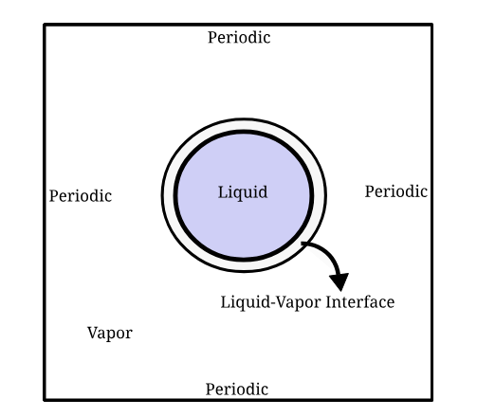
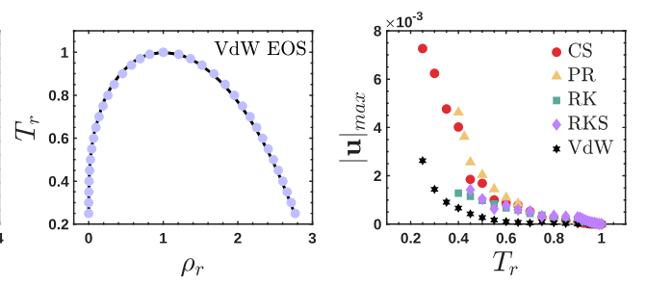
Thermodynamic Consistency
Idea: Benchmark of A(T), alpha(T), and kappa(T) using Laplace scenario (liquid droplet in coexisiting vapor).
Comparison of coexistence densities vs. T_red derived from LB simulations with predictions from the Maxwell construction for Van der Waals (and Carnhan-Starling (CS)) from MicTherm
Substance: test fluid ^{[1]}
EOS: VdW (CS)
Aggregate: liquid + gas
Thermal: constant, homogeneous temperature field
Scenario: available
[1] https://pubs.aip.org/pof/article/18/4/042101/915484/Equations-of-state-in-a-lattice-Boltzmann-model.

Slide 5
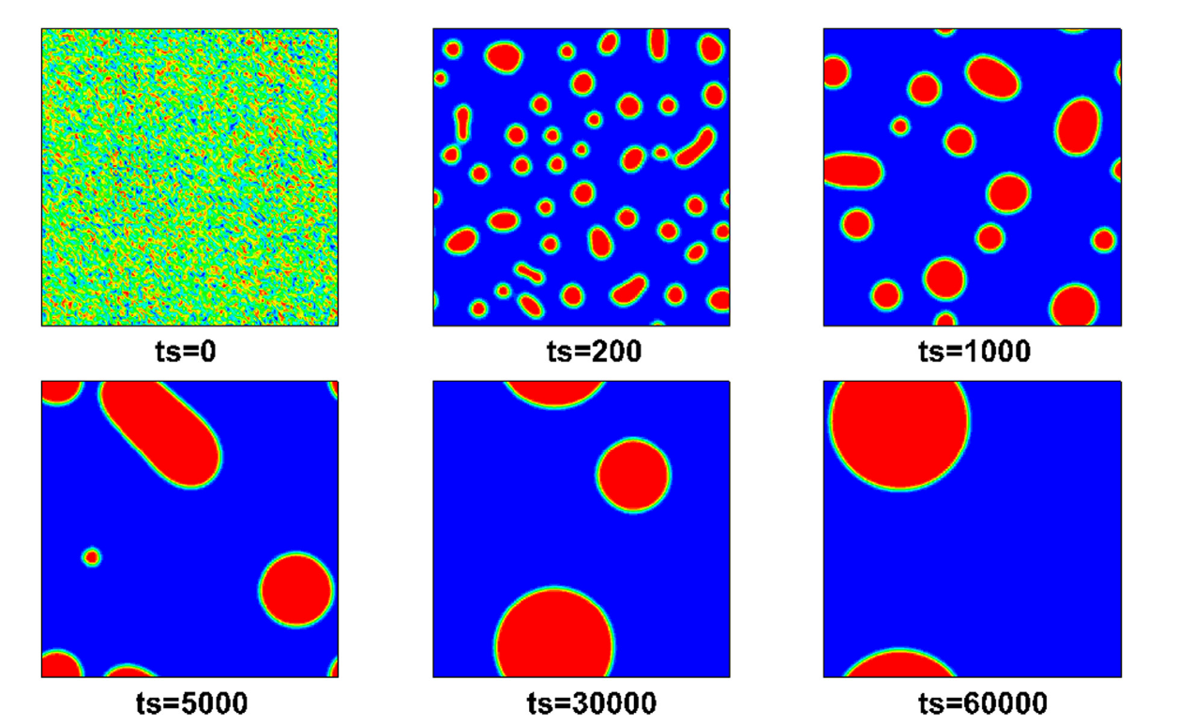
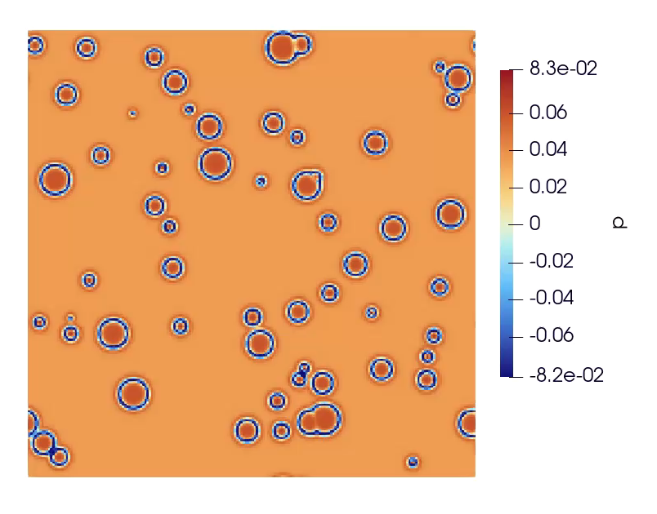
Phase Separation Process
^{[1]}
Idee: Phase separation initiates with the formation of small droplets or bubbles which progressively coalesce to form a larger droplet or bubble.
Substance: test fluid + real fluid
EOS: VdW + PC-SAFT
Aggregate: liquid + gas
Thermal: constant, homogeneous temperature field
Scenario: available
[1] https://linkinghub.elsevier.com/retrieve/pii/S0997754618302103

Slide 6
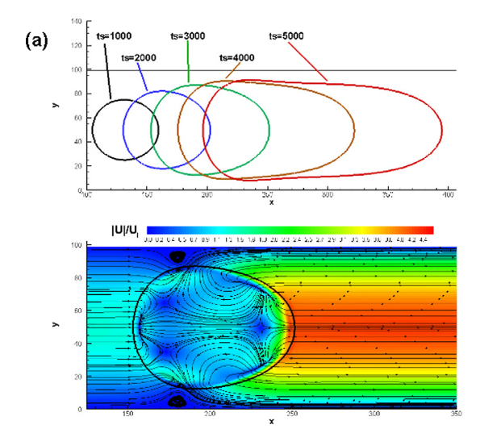
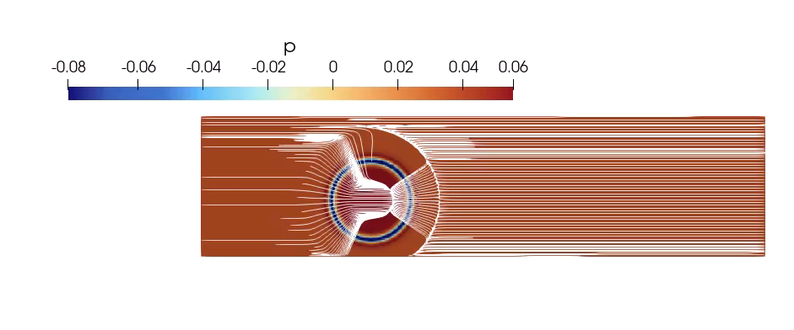
Single Cavitating Bubble under Poiseuille Flow
^{[1]}
Substance: test fluid + real fluid
EOS: VdW + PC-SAFT
Aggregate: liquid + gas
Thermal: constant, homogeneous temperature field
Scenario: moderate adaptation of existing scenarios, e.g., wall BC
[1] https://linkinghub.elsevier.com/retrieve/pii/S0997754618302103

Slide 7
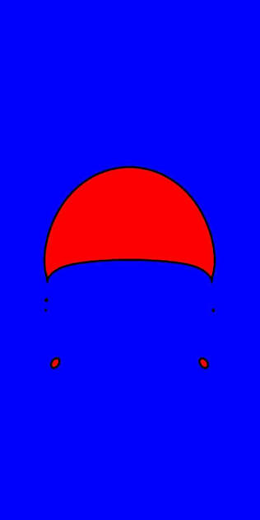
(Rising Bubble)
Substance: test fluid + real fluid
EOS: VdW + PC-SAFT
Aggregate: liquid + gas
Thermal: constant, homogeneous temperature field
Scenario: moderate adaptation of existing scenarios

Slide 8
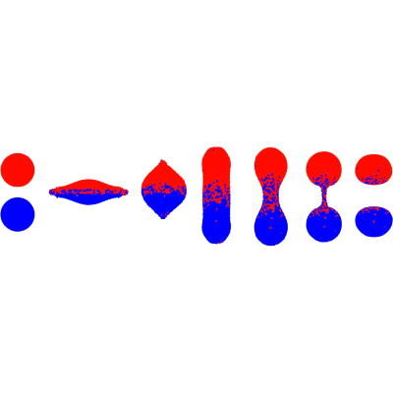
(Droplet Collision)
Substance: test fluid + real fluid
EOS: VdW + PC-SAFT
Aggregate: liquid + gas
Thermal: constant, homogeneous temperature field
Scenario: moderate adaptation of existing scenarios

Slide 9
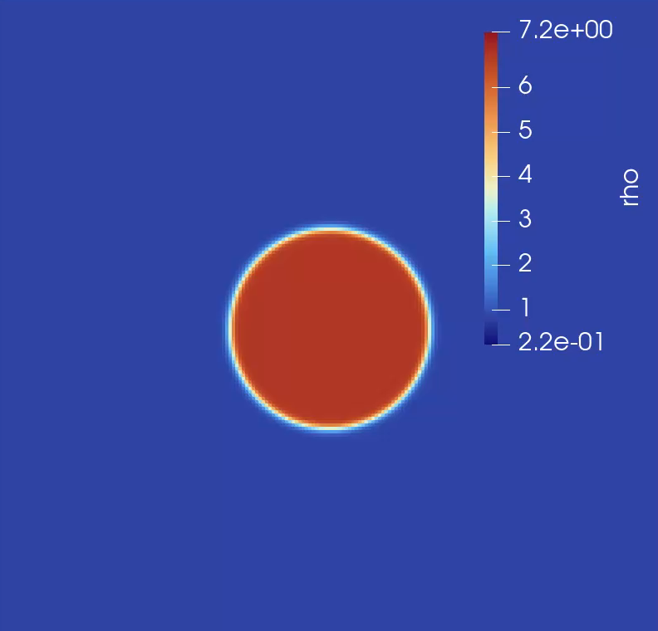
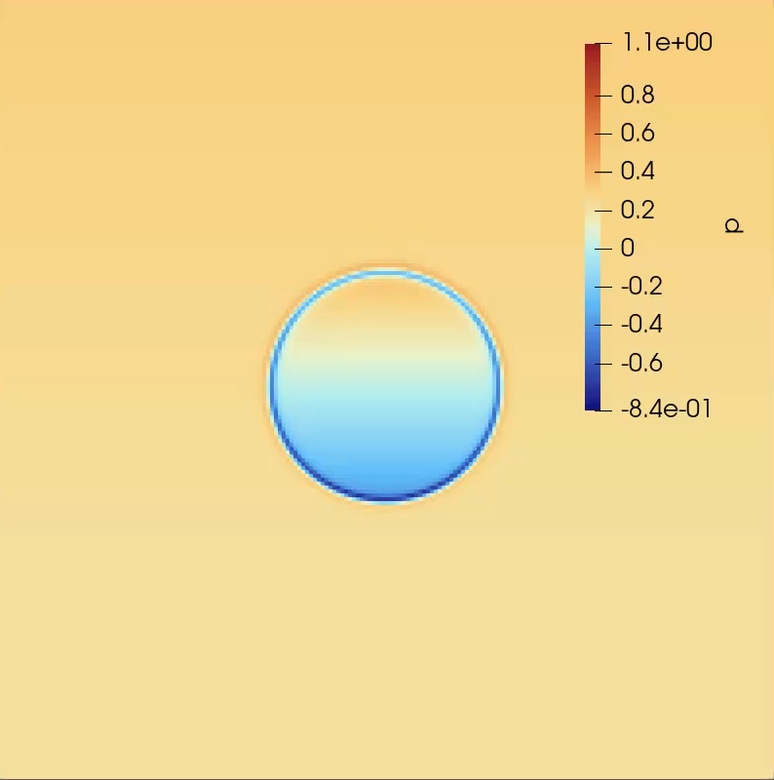
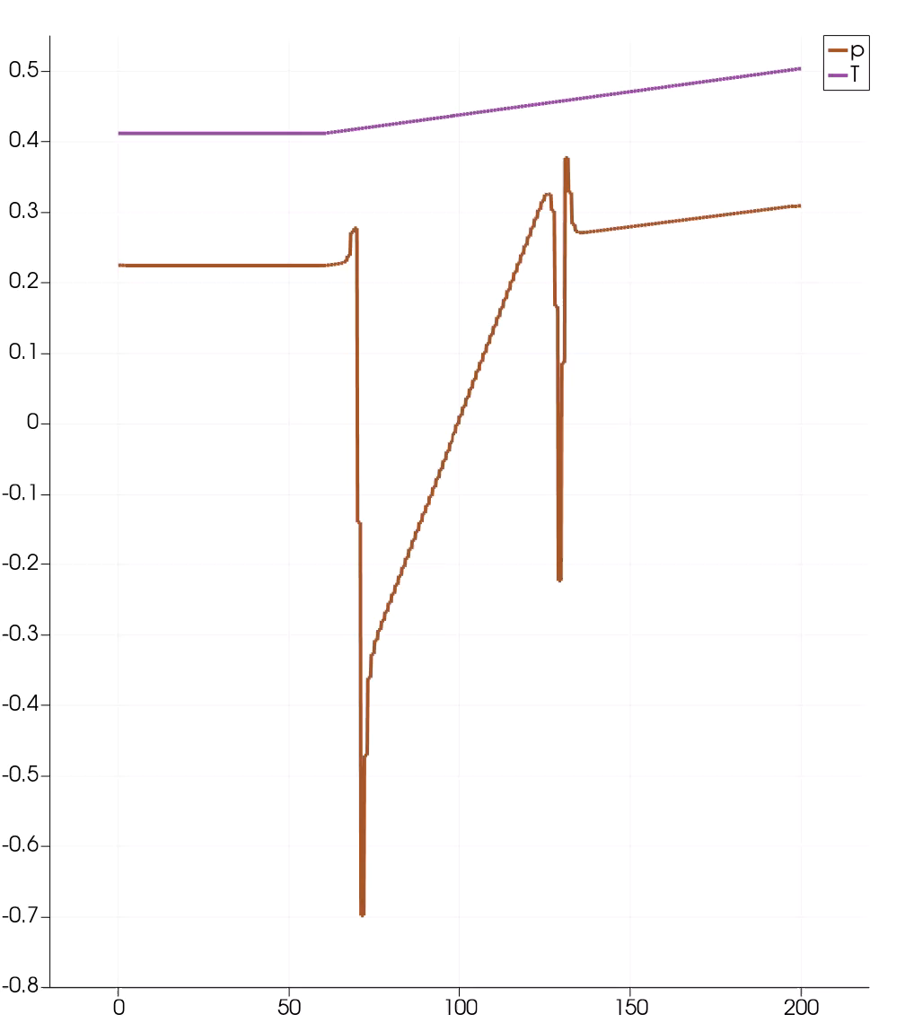
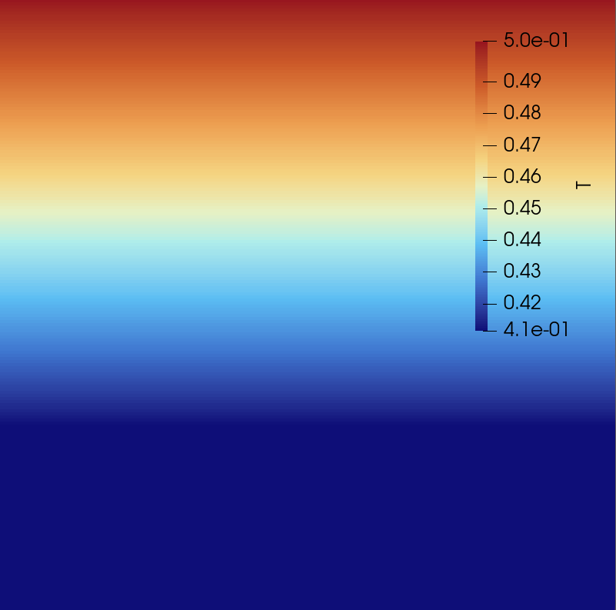
(Moving Droplet 2D in Fluid)
Idea: Droplet moves due temperature difference in the simulation szenario.
vapor
Substance: test fluid + real fluid
EOS: VdW + PC-SAFT
Aggregate: liquid + gas
Thermal: constant prescribed temperature gradient
Scenario: available
liquid

Slide 10
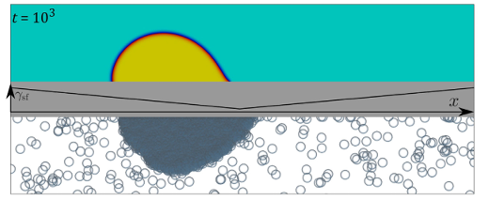
Moving Droplet 2D on Wall
Idea: Droplet moves due temperature difference on wall.
Substance: test fluid + real fluid
EOS: VdW + PC-SAFT
Aggregate: liquid + gas
Thermal: constant prescribed temperature gradient (or spatially prescribed contact angles at constant temperature)
Scenario: moderate adaptation of existing scenarios
liquid

Slide 11
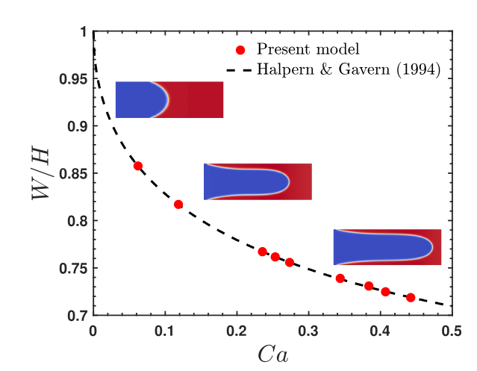
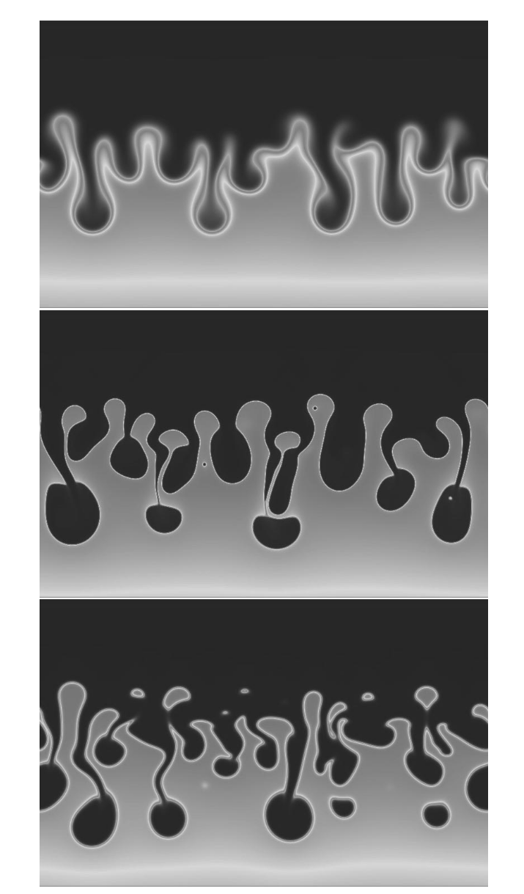
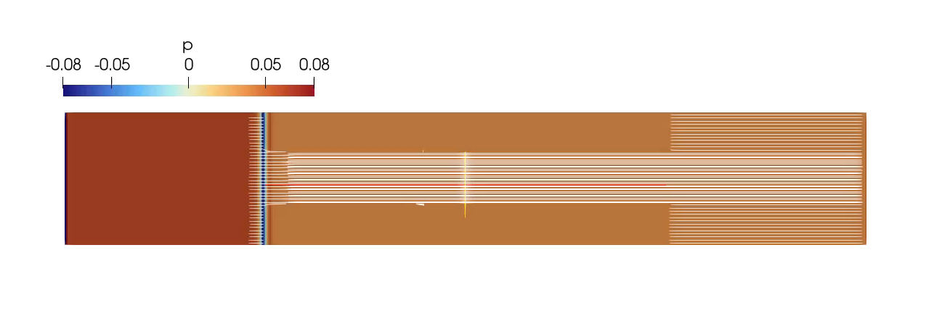
Viscous Fingering + Hele-Shaw
Substance: two fluids with different viscosity
EOS: VdW + PC-SAFT
Aggregate: liquid + gas
Thermal: constant, homogeneous temperature field
Scenario: moderate adaptation of existing scenarios
^{[1]}
[1] https://www.worldscientific.com/doi/abs/10.1142/S0217979203017023

Slide 12
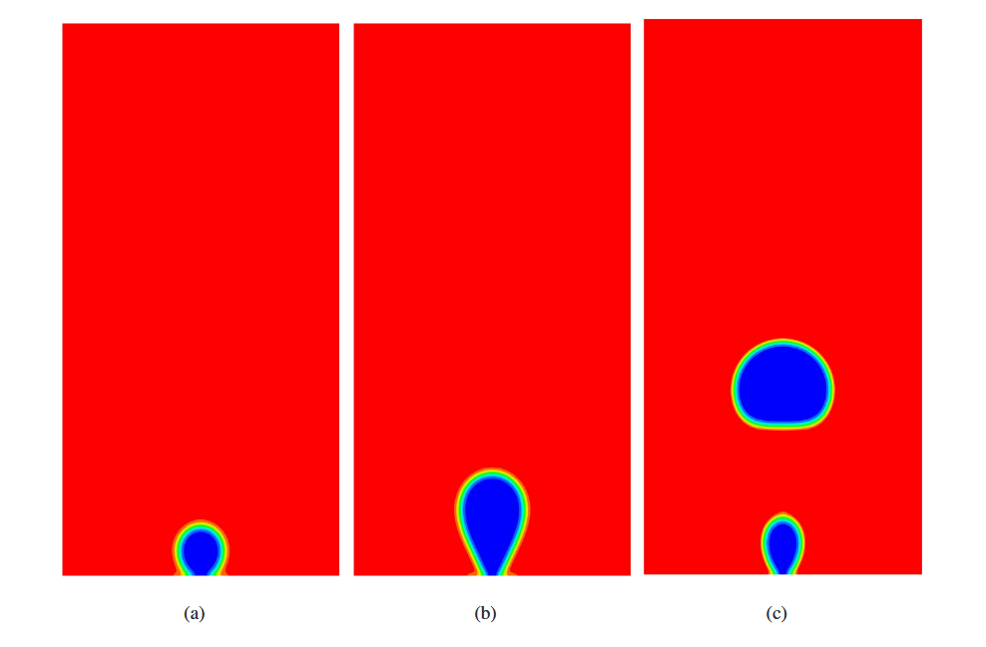
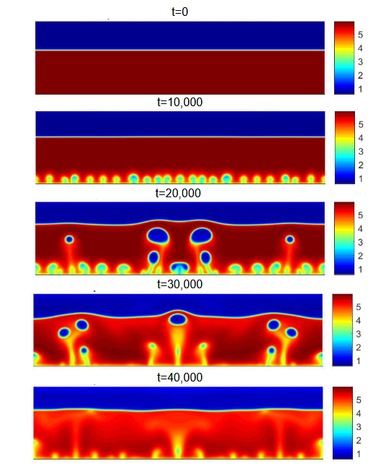
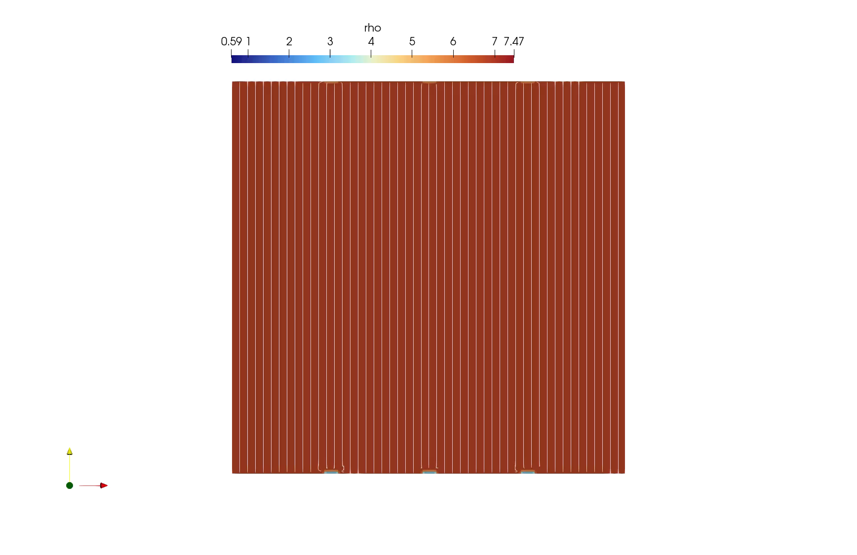
Bubble Detachment
Substance: test fluid + real fluid
EOS: VdW + PC-SAFT
Aggregate: liquid + gas
Thermal: constant prescribed temperature gradient
Scenario: larger adaptation of existing scenarios
^{[1]}
^{[2]}
[1] http://arxiv.org/abs/2205.00686. [2] https://www.mdpi.com/2311-5521/10/4/90

Slide 13
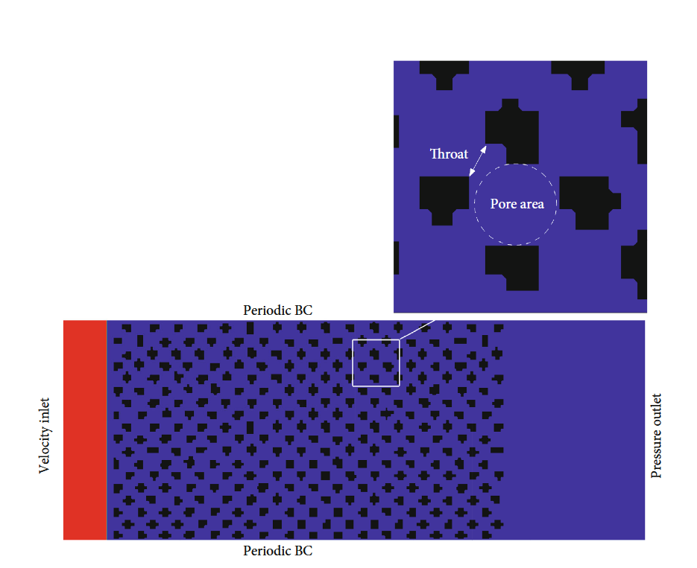
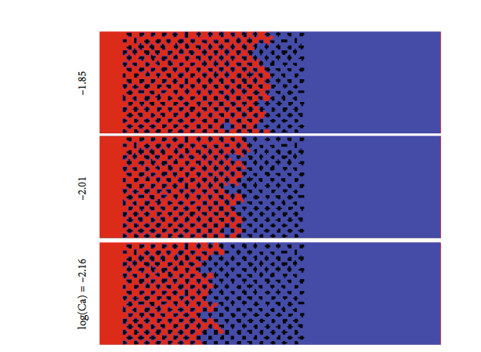
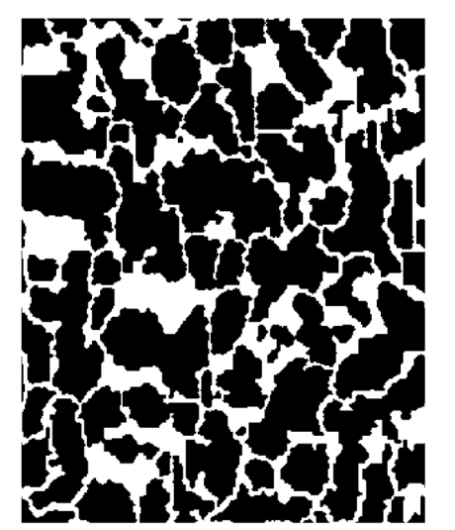
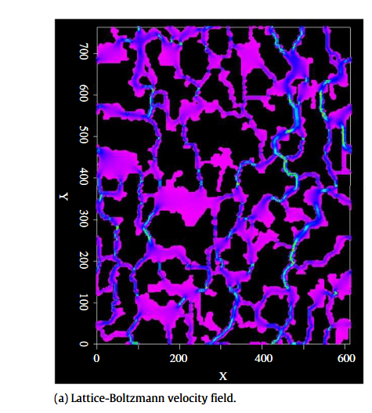
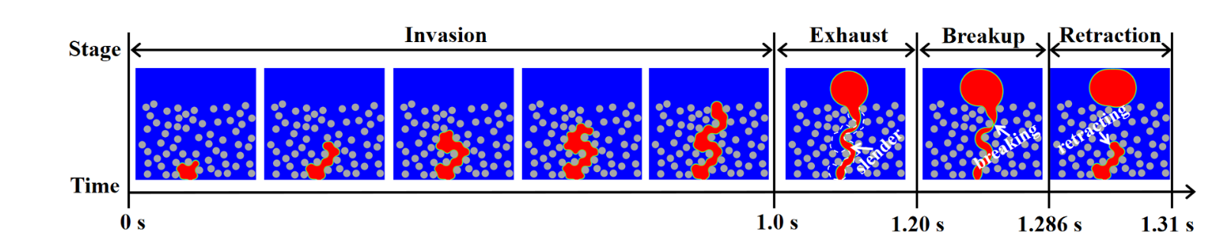
Two-Phase Flow in Porous Medium
Substance: two fluids (with at high density/ viscosity ratio)
EOS: VdW + PC-SAFT
Aggregate: liquid + gas
Thermal: constant, homogeneous temperature field or constant temperature gradient
Scenario: moderate-to-large adaptation of existing scenarios, e.g. incl. porous medium (artificial geometry or realistic rock geometries)
^{[1]}
^{[3]}
[1] https://www.hindawi.com/journals/geofluids/2021/5668743/ [2] https://linkinghub.elsevier.com/retrieve/pii/S0898122109006427
[3] https://linkinghub.elsevier.com/retrieve/pii/S0009250924004408​

Slide 14
3D?!

